Slide 1
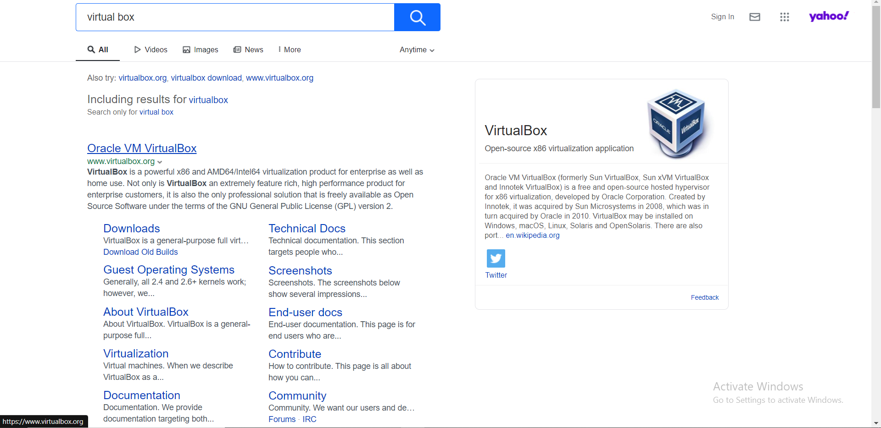
Download virtual box Step 1

Slide 2
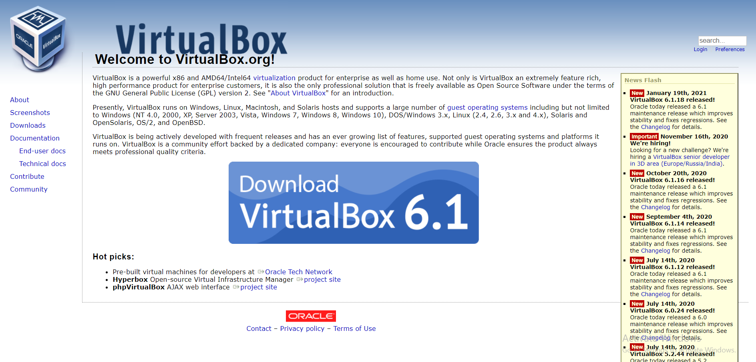
Download virtual box Step 2
Press here

Slide 3
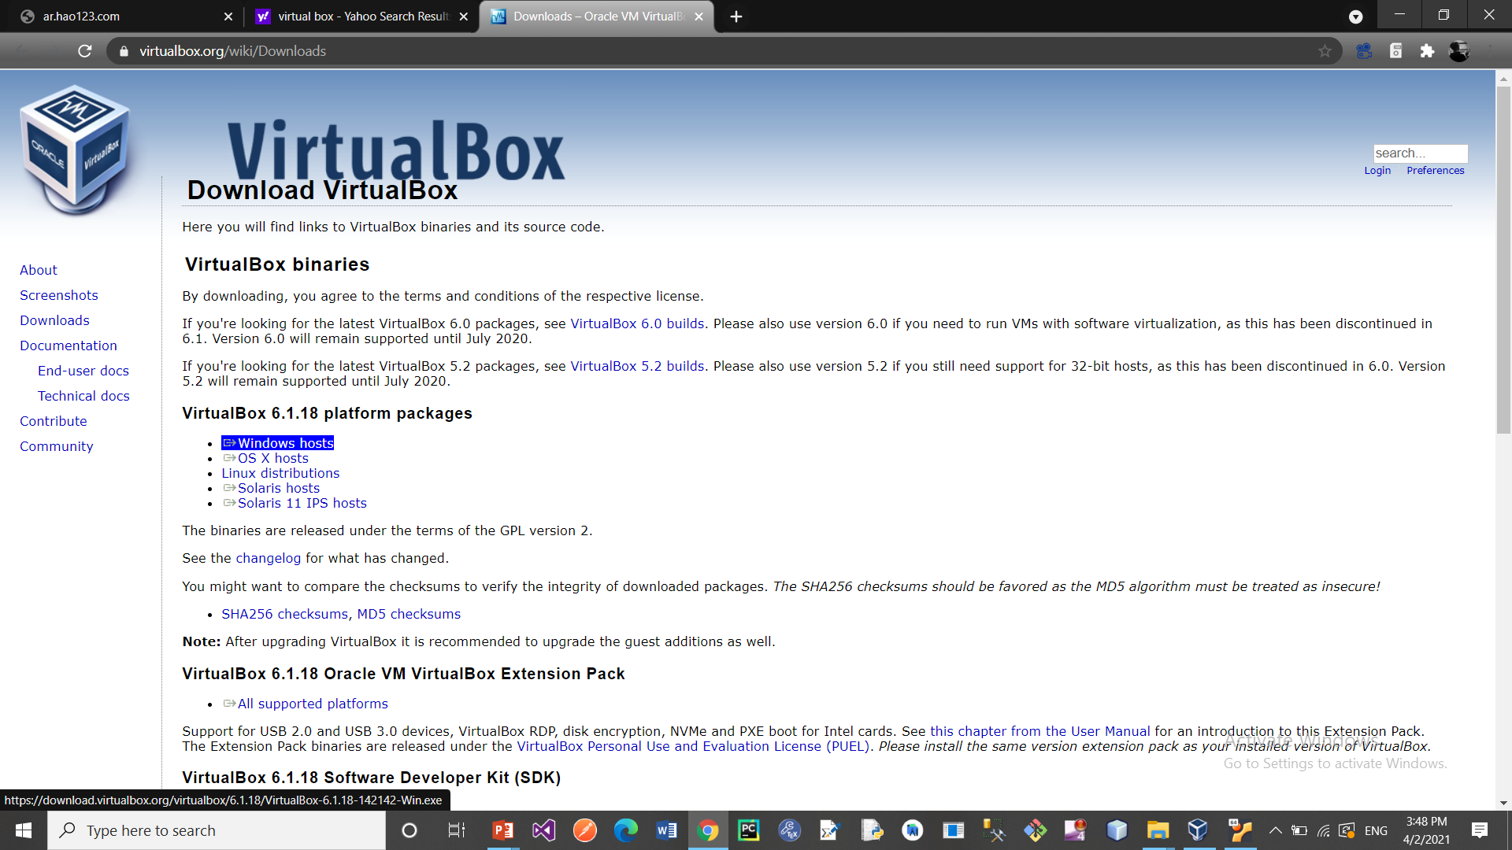
Download virtual box Step 3
Press here

Slide 4
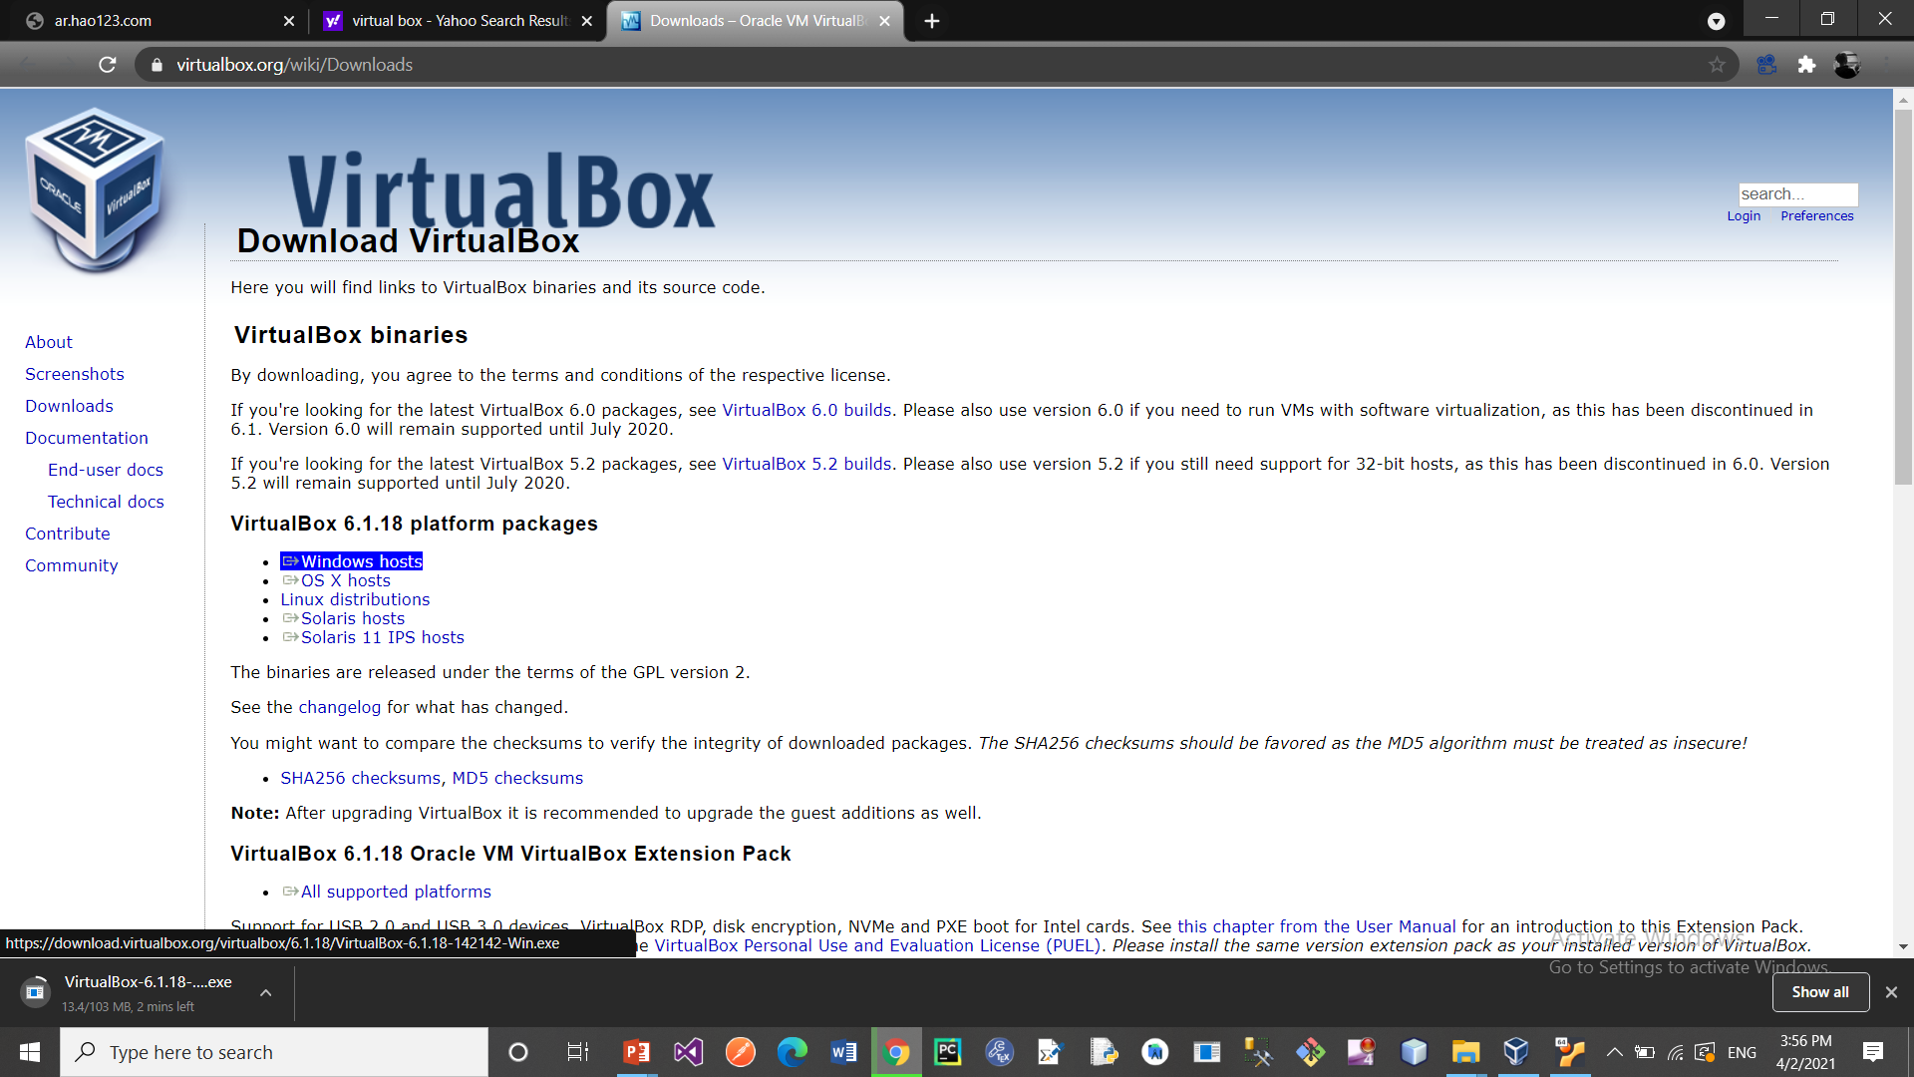
Download virtual box Step final

Slide 5
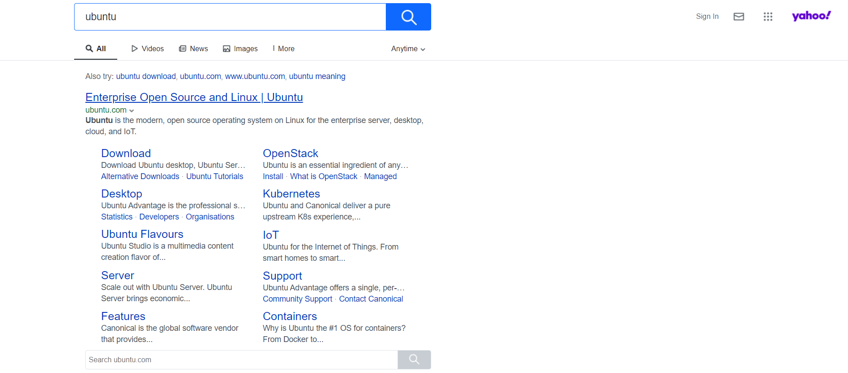
Download Ubuntu Step 1

Slide 6
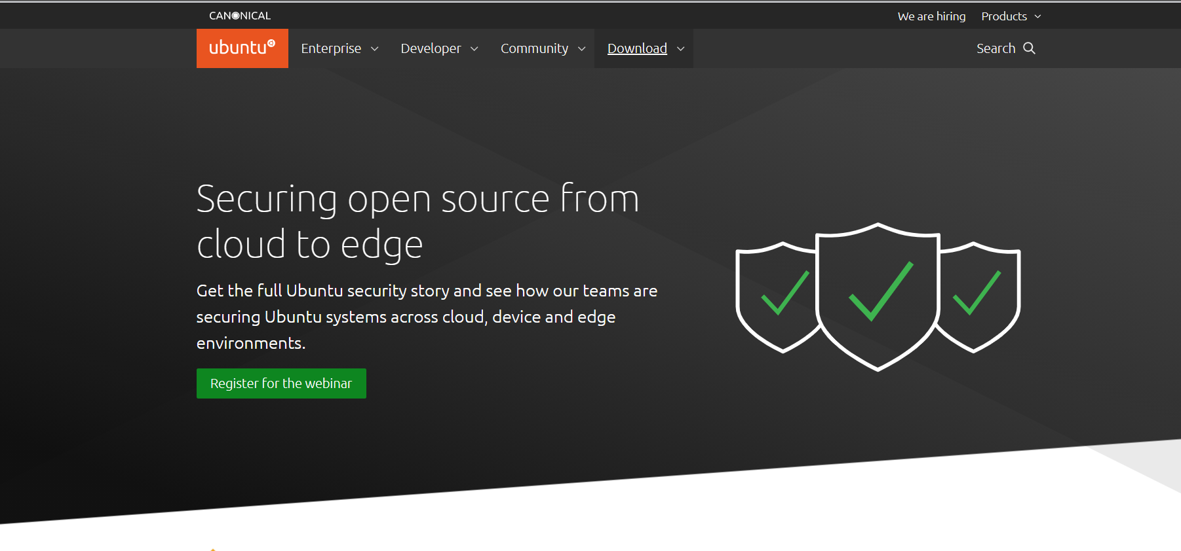
Download Ubuntu Step 2
Press here

Slide 7
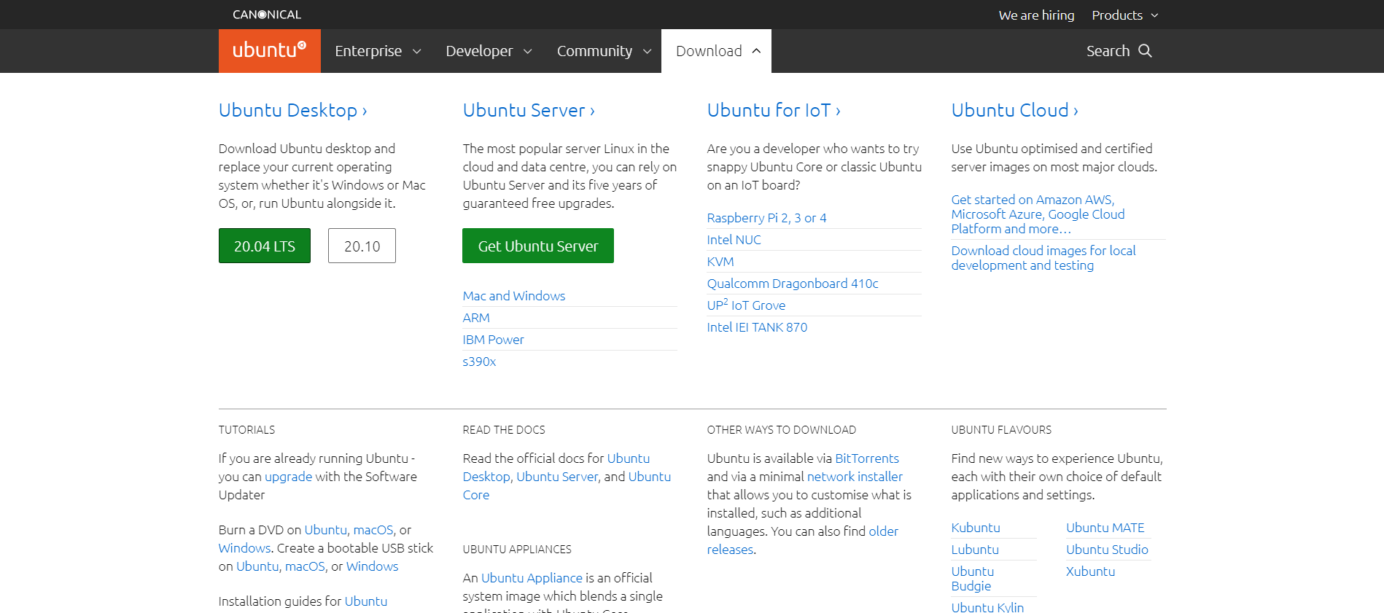
Download Ubuntu Step 3
Press here

Slide 8
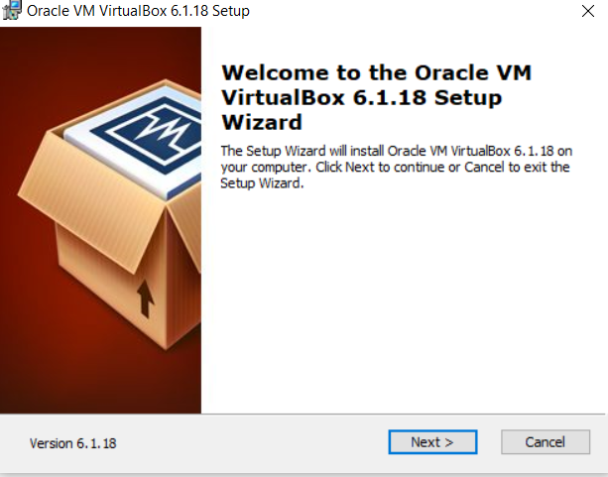
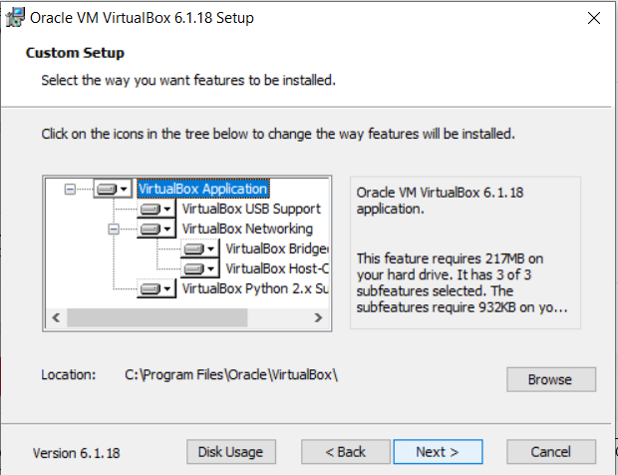
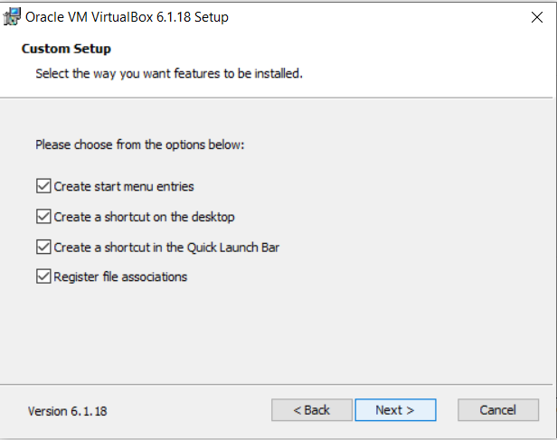
Install virtual box Step 1

Slide 9
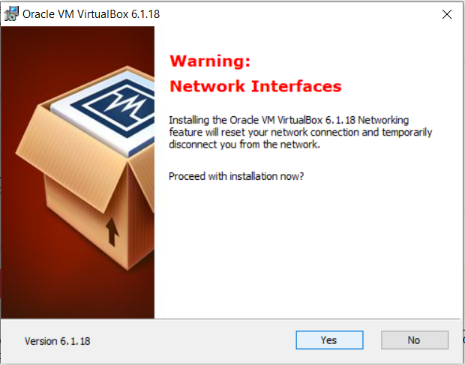
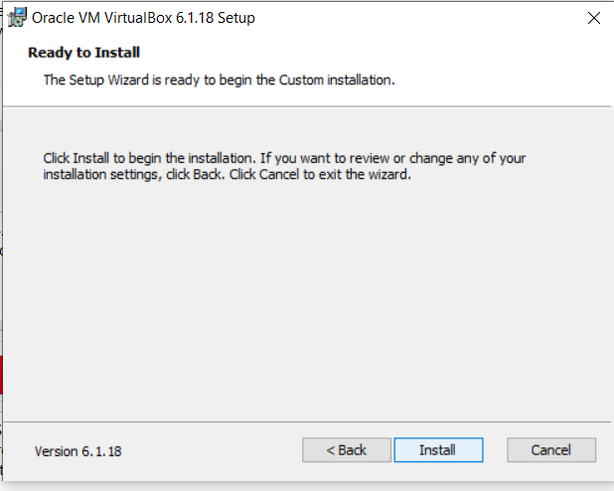
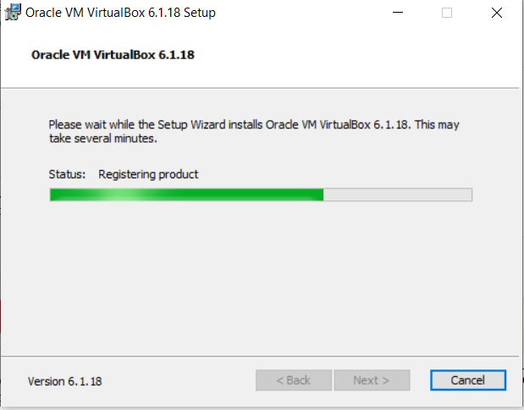
Install virtual box Step 2

Slide 10
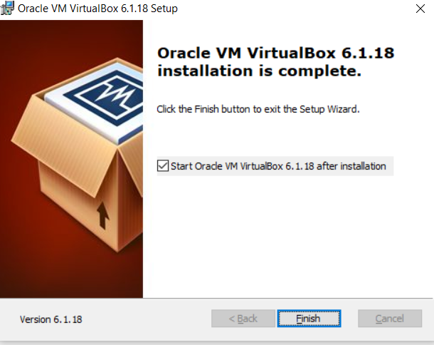
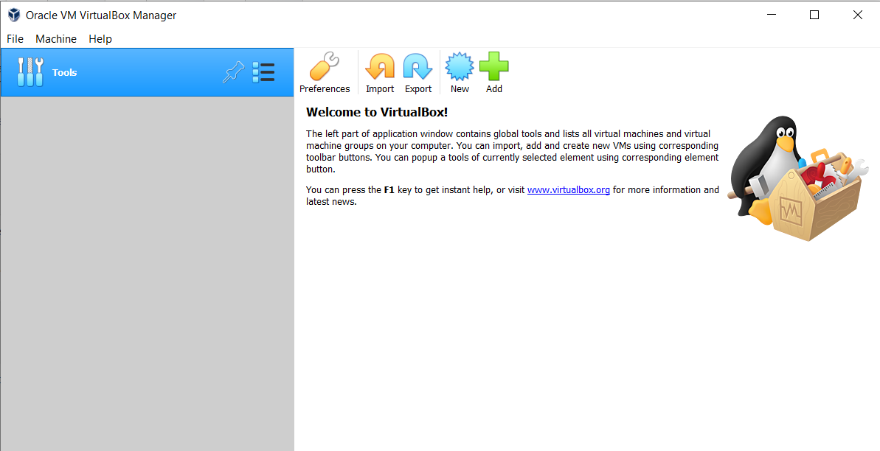
Install virtual box Step 3

Slide 11
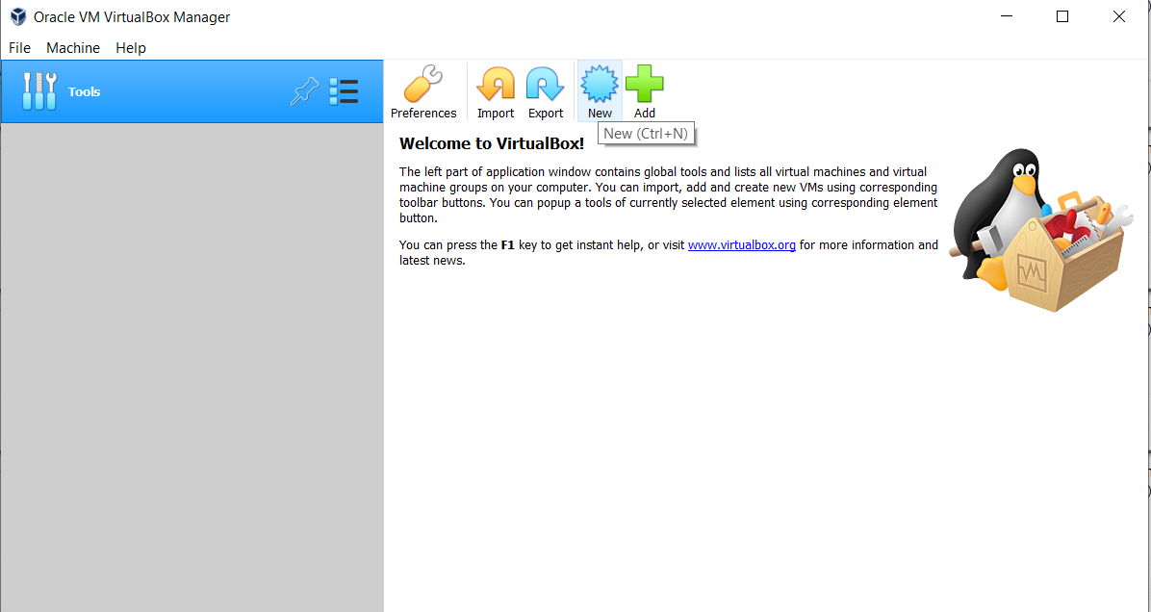
Create new device Step 1
Press here

Slide 12
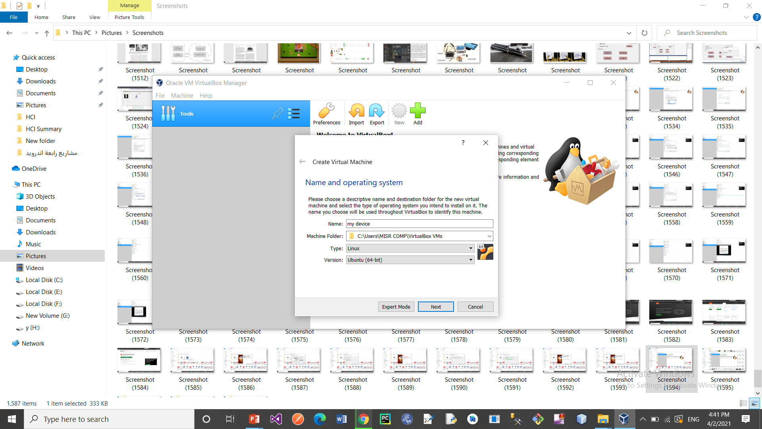
Create new device Step 2
Enter information of your device
(64 / 32 according your device)

Slide 13
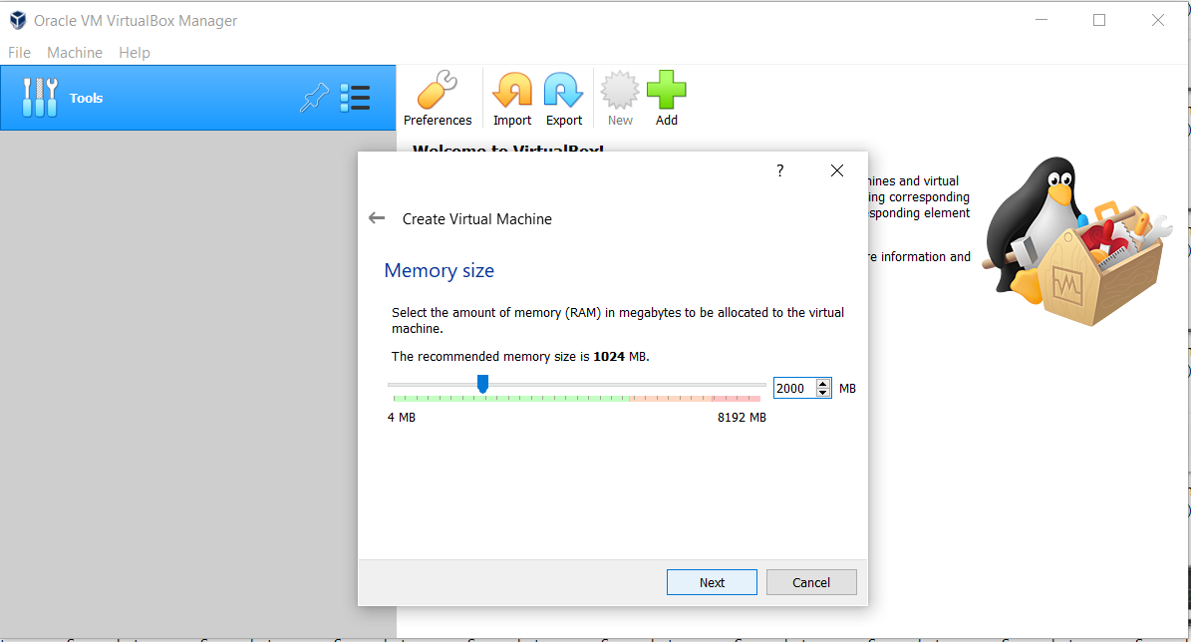
Create new device Step 3
Enter ram size

Slide 14
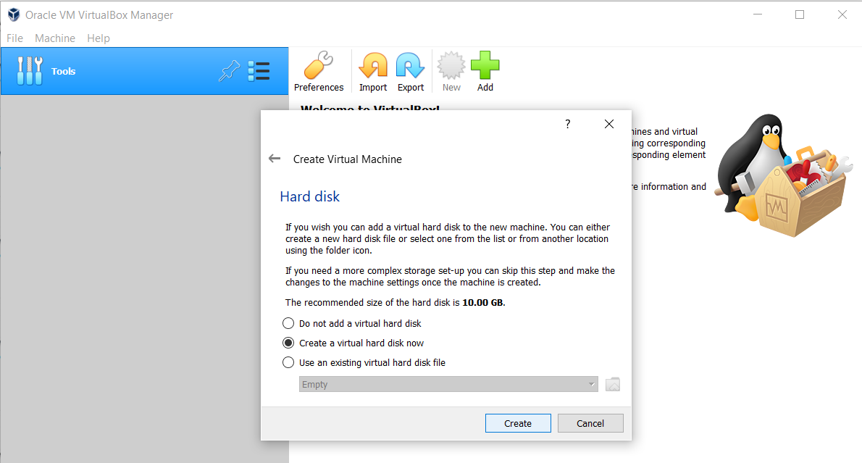
Create new device Step 4

Slide 15
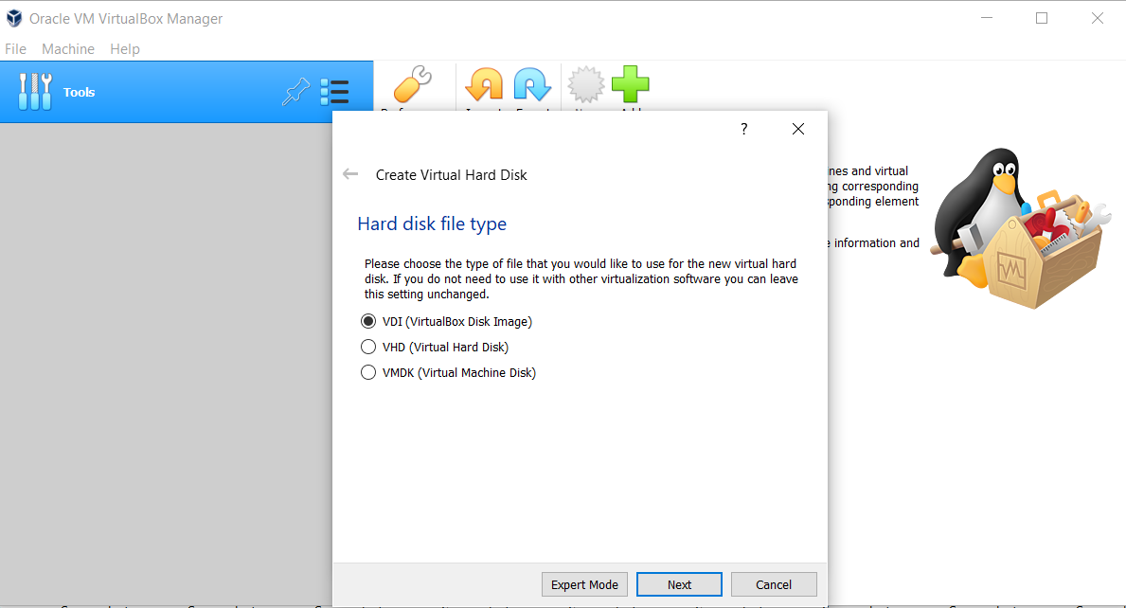
Create new device Step 5

Slide 16
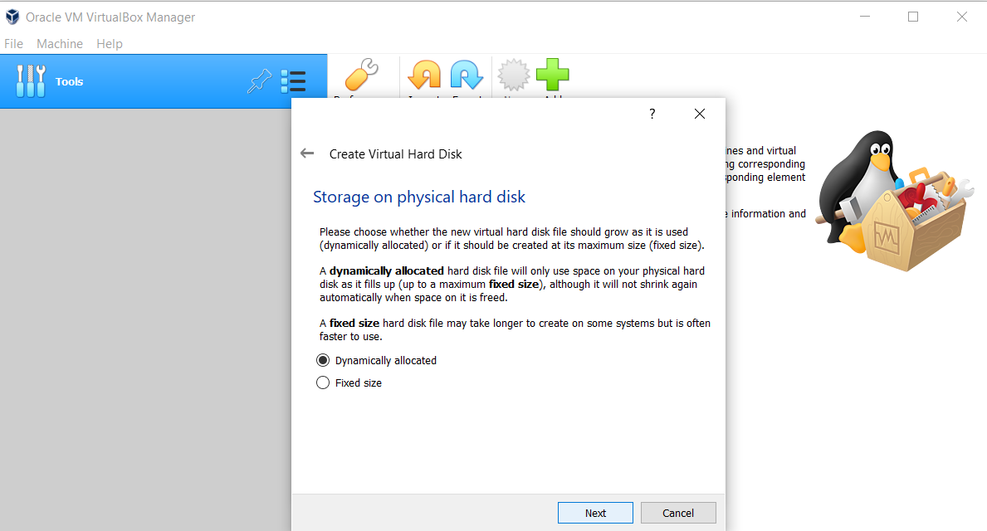
Create new device Step 6

Slide 17

Create new device Step 7
Enter hard size

Slide 18
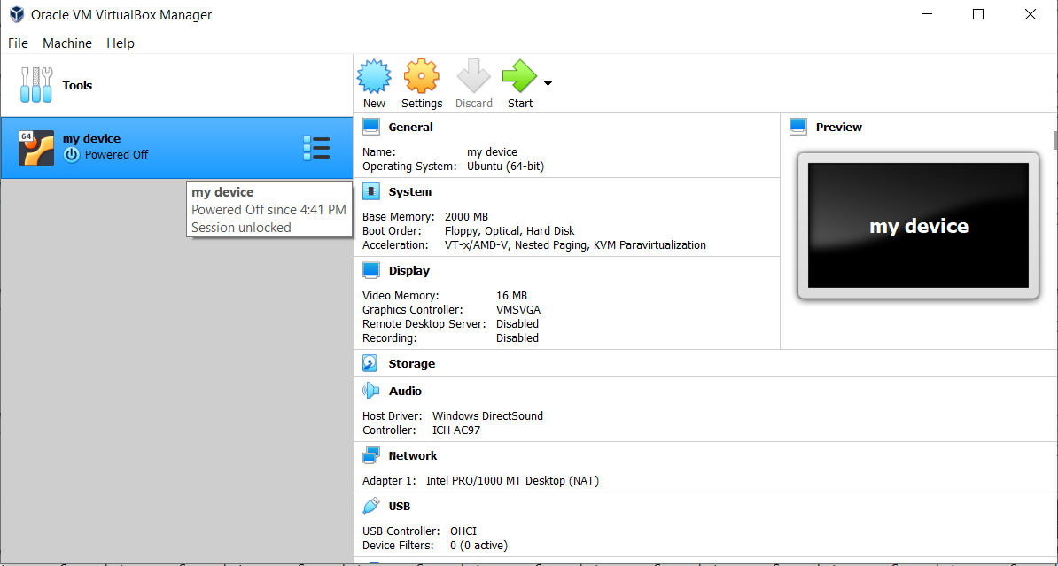
Create new device Step 8

Slide 19
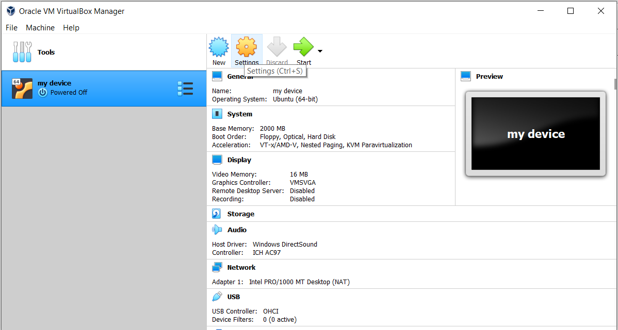
New device setting Step 1
Then Press here
Press here first

Slide 20
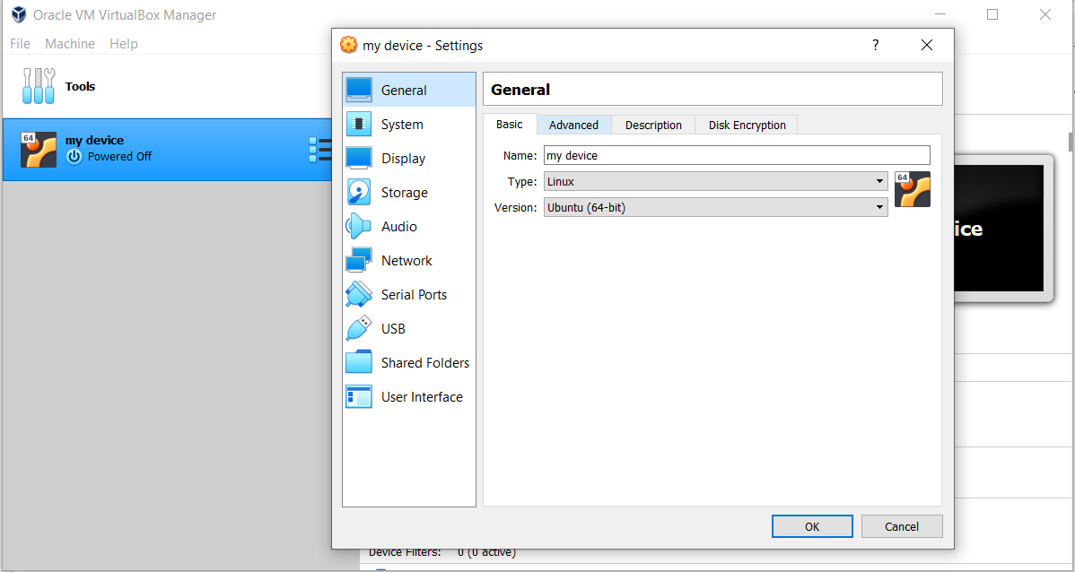
New device setting Step 2
1
2

Slide 21
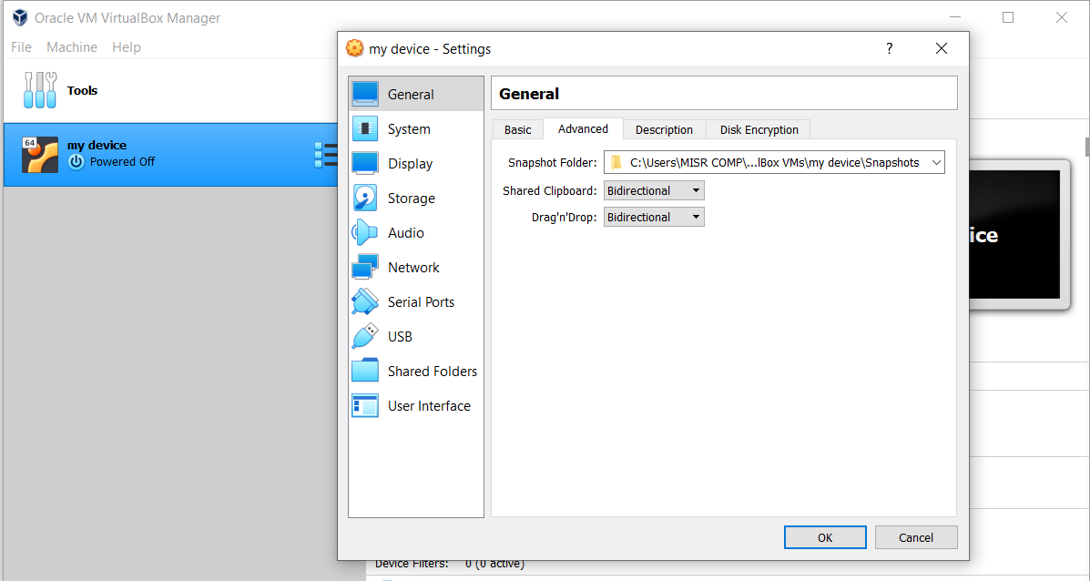
New device setting Step 3
Select this

Slide 22

New device setting Step 4
2
1
3

Slide 23
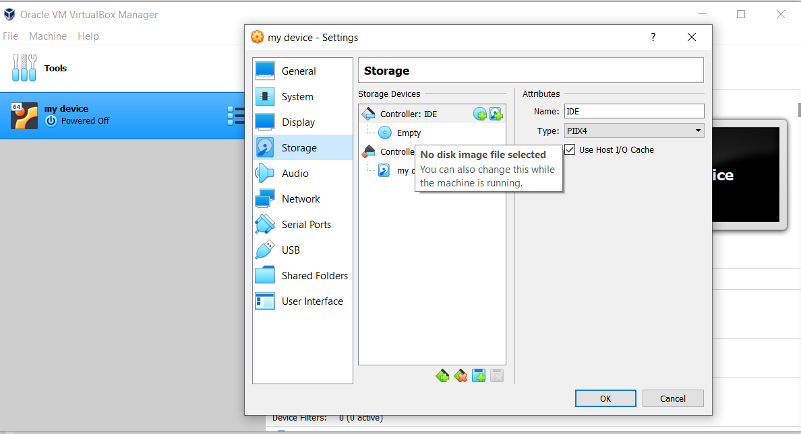
New device setting Step 5
2
1

Slide 24
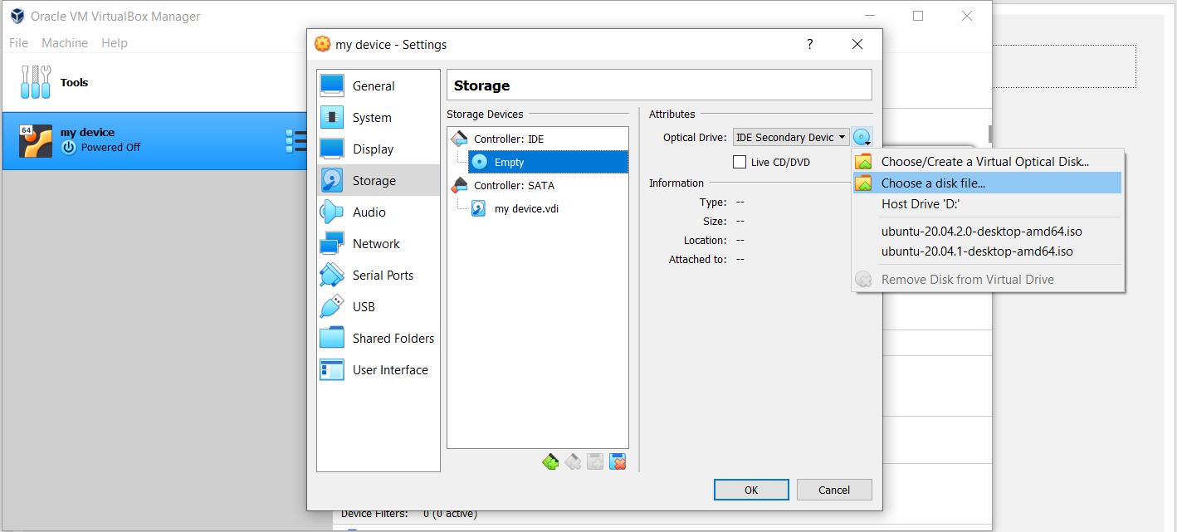
New device setting Step 6
Press here

Slide 25
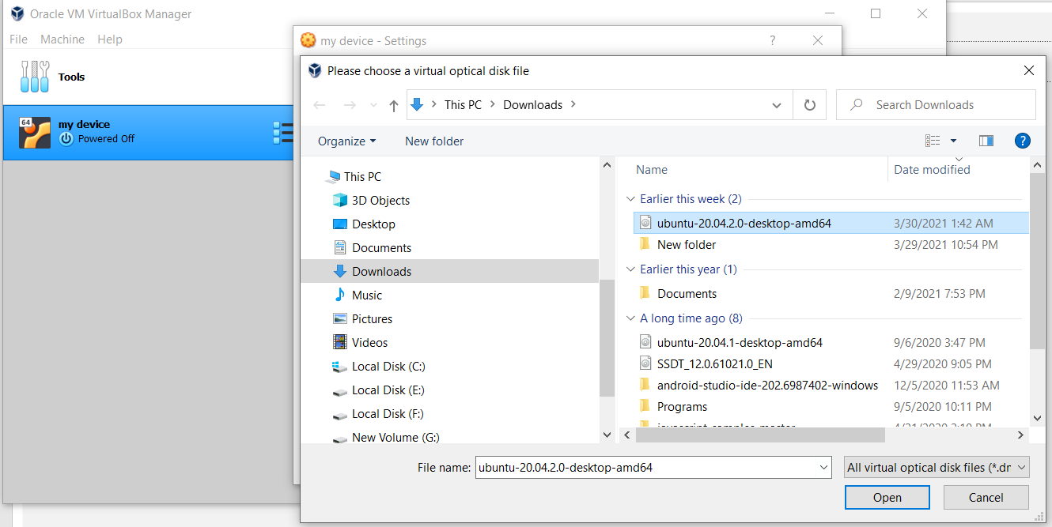
New device setting Step 7
Select ubuntu version

Slide 26
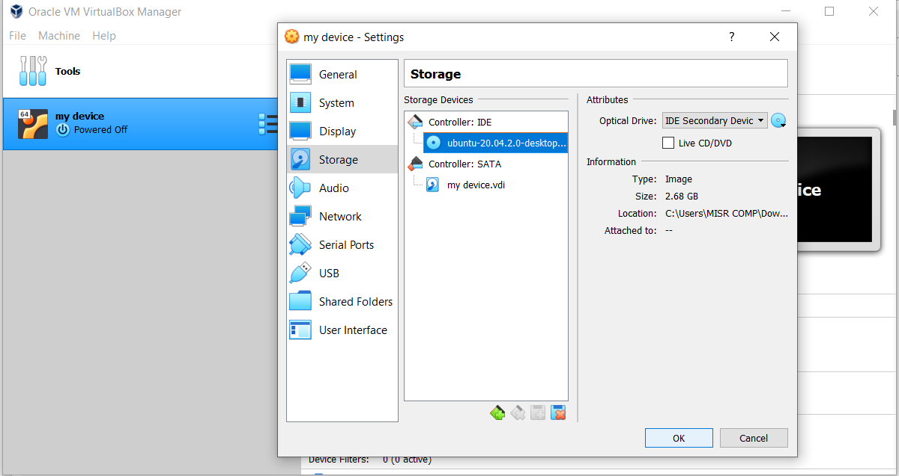
New device setting Step 8
Press here

Slide 27
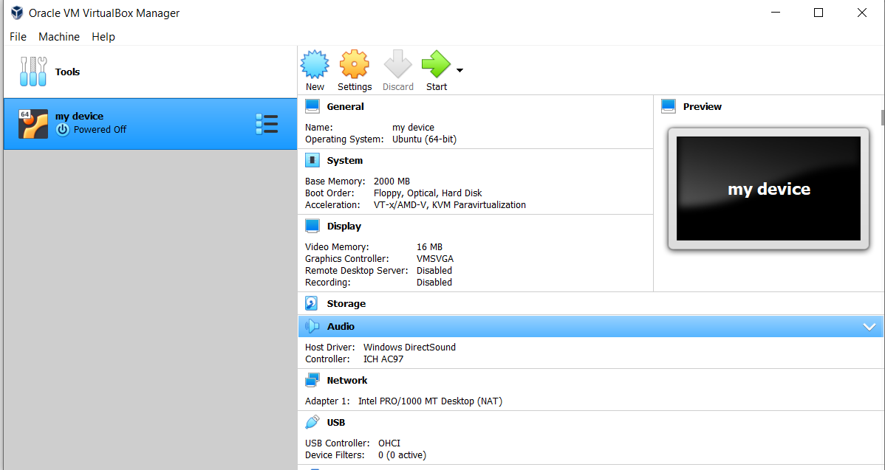
Start device
Start your device

Slide 28
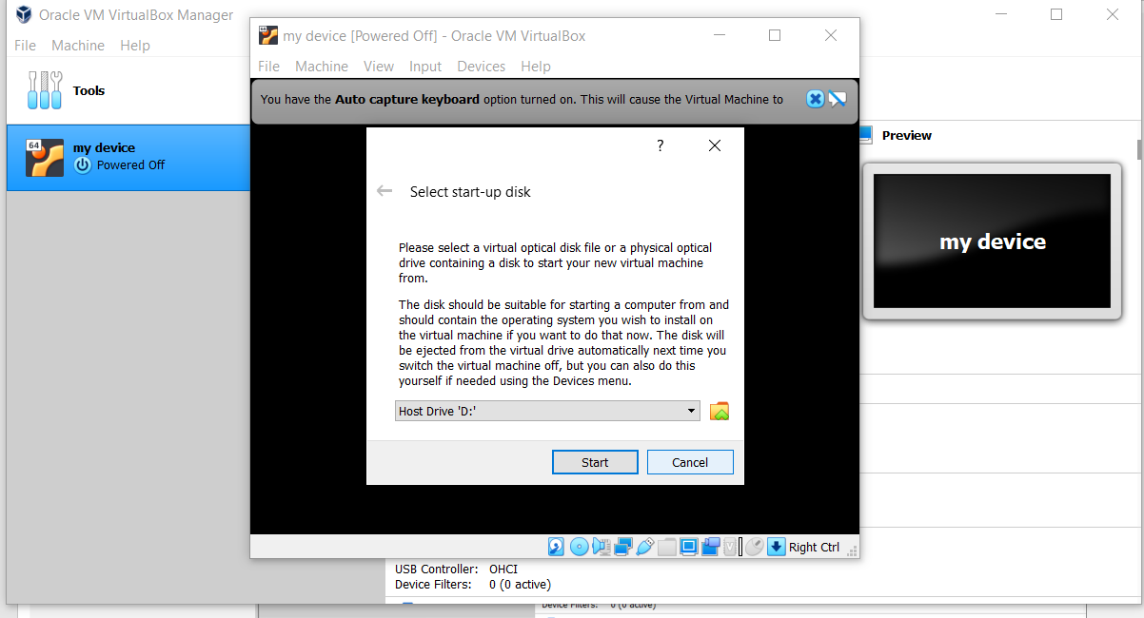
Start device
Select cancel

Slide 29
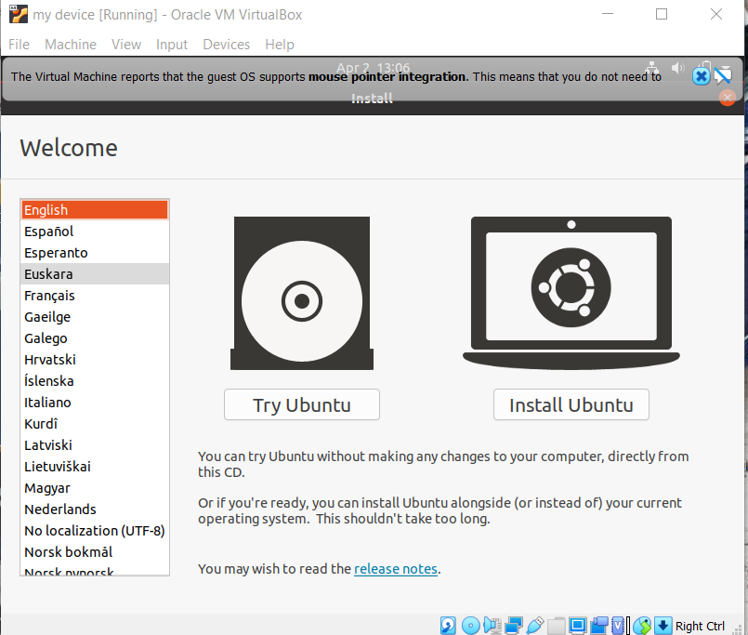
Start device
Select try

